Slide 1
Ubuntu
and basic Linux command part 1
Nguyen Quang Khai
19/05/2024

Slide 2
Contents
1. Introduction: Ubuntu, file systems, some terms.
2. Some basic Linux commands work with files and directories.
- Change working directory.
- List content.
- Create.
- Remove.
- Copy.
- Move.

Slide 3
Introduction

Slide 4
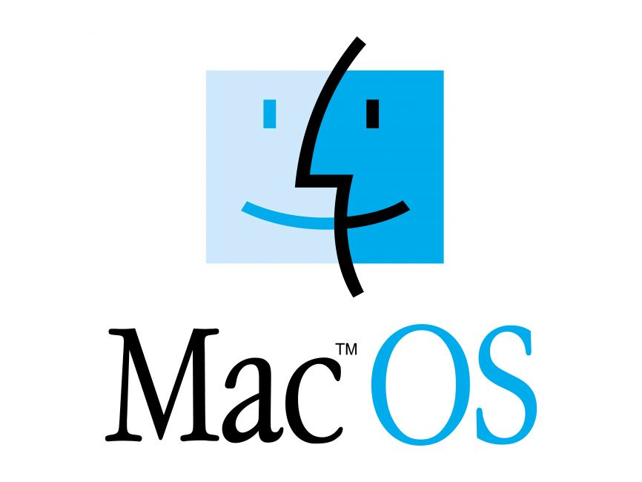



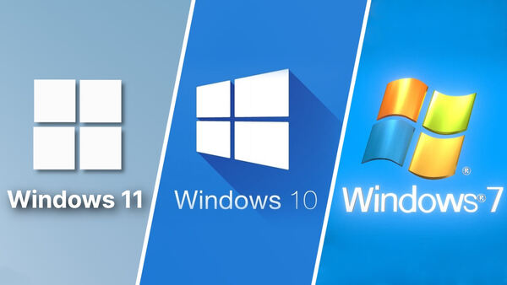
Some popular Operating Systems

Slide 5





Distributions of linux (OS)
Ubuntu OS has the most users

Slide 6
Why linux in bioinformatics?
Linux is an open-source operating system.
- Allows users to customize their systems according to their specific needs.
- It is free.
Linux is the most commonly used operating system in High-Performance Computing (HPC). HPC unlocks primary challenges in bioinformatics:
- Data processing limits.
- Slow analysis times.
- Impact on research progress.
Most bioinformatics tools and applications are designed to be run on Linux-based operating systems.

Slide 7
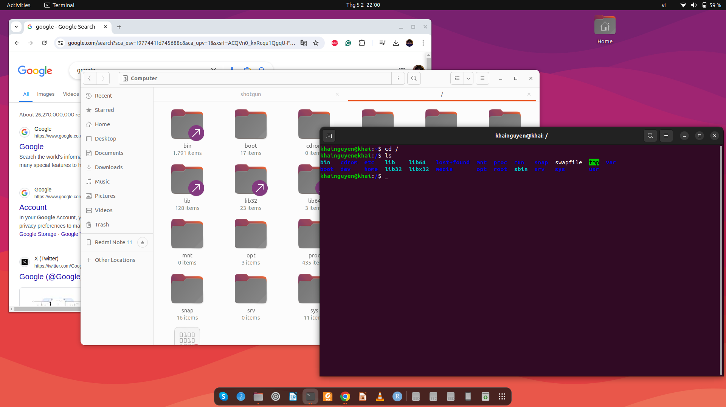
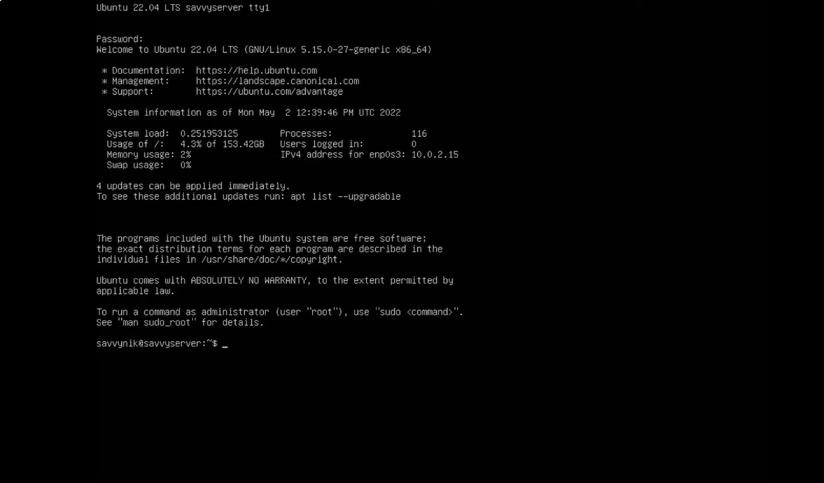
interact with the software/package
graphic user interface - GUI
(mouse + keyboard)
also called
command line interface - CLI
(keyboard)
Ubuntu desktop: GUI + CLI
Ubuntu server: only CLI

Slide 8
Terminal
Terminal window
is where you type commands
Open:
Ctrl + Alt + T keys on the keyboard
Ubuntu desktop

Slide 9
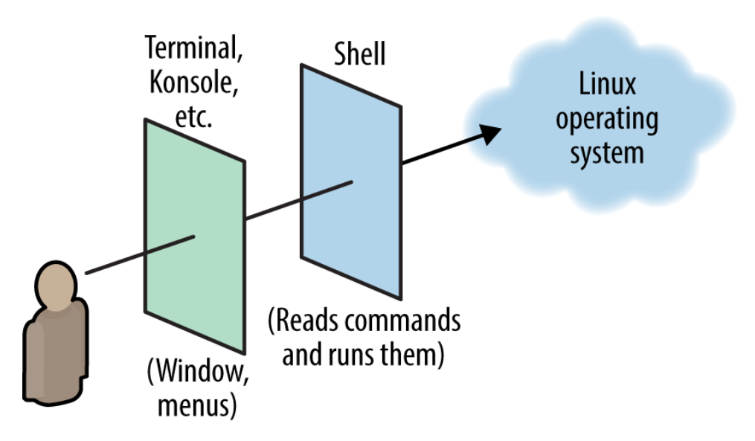

What is Shell?
- A shell is a special user program that provides an interface for the user to use operating system services.
- Terminal is where we interact with the shell through commands.
- Several types of Shell:
+Bourne Shell (sh)
+ C Shell (csh)
+Bourne Again Shell (bash): most popular
+ Z Shell (zsh)
(Daniel J. Barrett, Linux pocket guide)

Slide 10
Some ways to get the Terminal
easy to install
1.
macOS: How to open Terminal:
https://support.apple.com/en-vn/guide/terminal/apd5265185d-f365-44cb-8b09-71a064a42125/mac
Windows 10/11: Install Ubuntu on Windows Subsystem for Linux (WSL): Recommended for beginners
https://canonical-ubuntu-wsl.readthedocs-hosted.com/en/latest/guides/install-ubuntu-wsl2/
2. Install Ubuntu on virtual machine (VM):
Windows: Install Ubuntu on VirtualBox: https://www.youtube.com/watch?v=ngJQPt-xEeo
macOS: Install Ubuntu on VirtualBox: https://www.youtube.com/watch?v=b_tOialCSXE
3. Install Ubuntu on physical computer: Best for long term use
Delete Windows & install Ubuntu: https://www.youtube.com/watch?v=oZcvqfWf_ps&t=100s
If you don't want to delete windows:
or a) Dual boot: Ubuntu and Windows on the same hard drive:
https://www.youtube.com/watch?v=GXxTxBPKecQ&t=229s
or b) Dual boot: Ubuntu and Windows on the separate hard drive:
(Ubuntu on hard drive 1, Windows on hard drive 2)
https://www.youtube.com/watch?v=KX85vZ3ANVk
Recommended method b) if you want dual-boot.
Warning: backup your data before install!!
More reference: https://www.youtube.com/watch?v=oZcvqfWf_ps&t=100s
a bit difficult to install

Slide 11
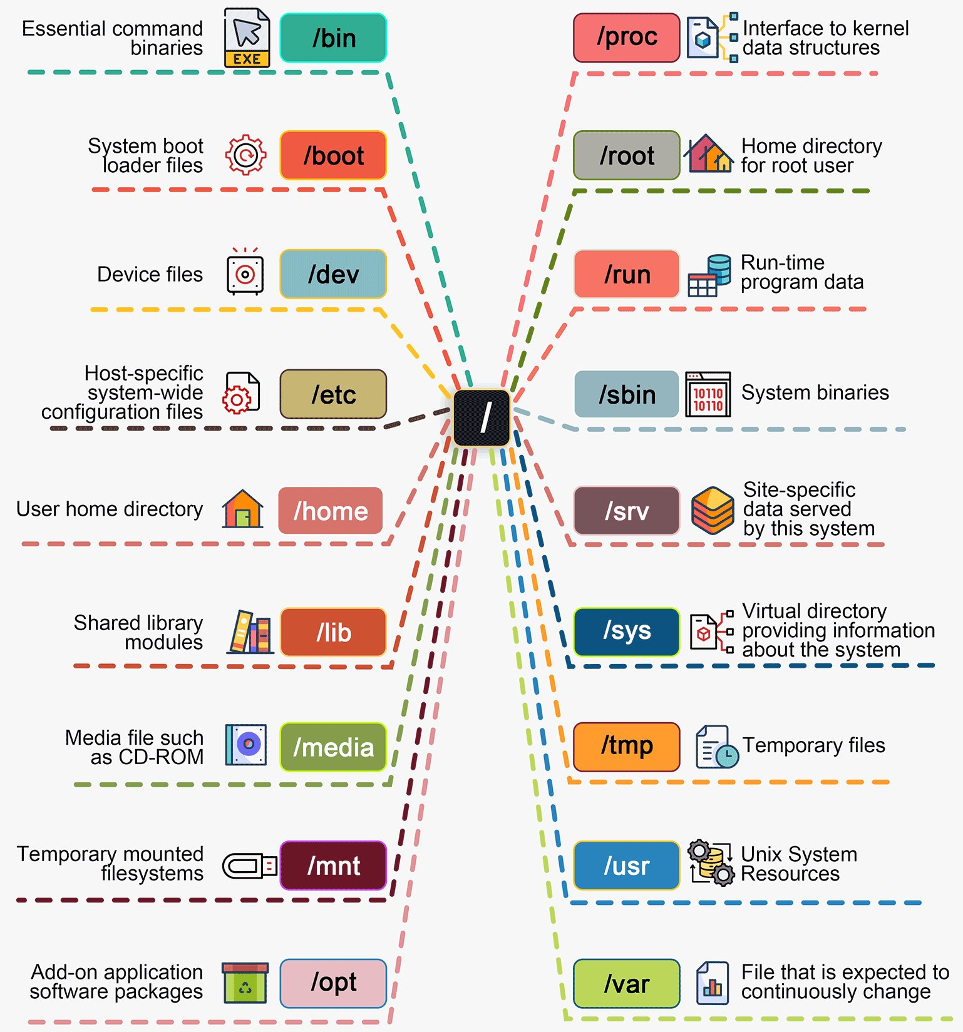
Linux file systems
Root
directory
The root directory is a special directory that contains all of the other files and directories on the computer. The root directory is specified as a / at the beginning of a path
user_name directory (or folder):
/home/khainguyen/
/home/vanA/
/home/vanB/
https://x.com/bytebytego/status/1764911444993495121

Slide 12
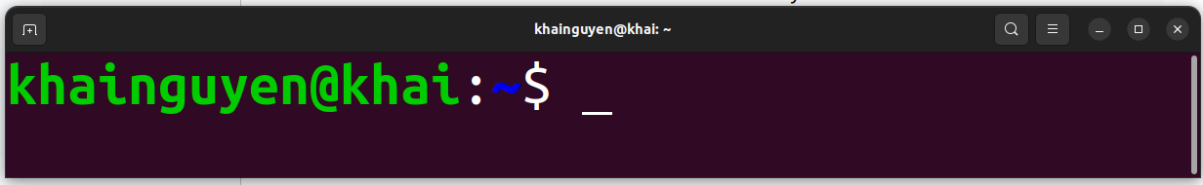
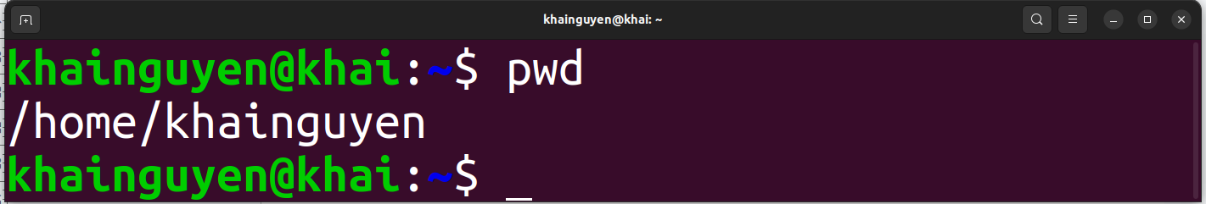

When opening the terminal, default:
$ means non-root user
tell you the computer is ready to accept a command
command
prompt
cursor
user_name
host name
The tilde ( ~ ) represents the home directory of the currently logged in ‘user_name’
This case, user_name is khainguyen, so the path is: /home/khainguyen
ENTER
To print the current path, type the command: pwd
,then hitting the ENTER key on keyboard to run the command
stands for ‘print working directory’

Slide 13
A basic command, could be:
Example: ls command
The command line will be read from left to right by the shell once press ENTER
command
(must have)
a space
option/flag
(optional)
hyphen-prefixed characters
a space
parameter
(optional)

Slide 14
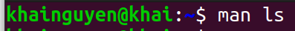
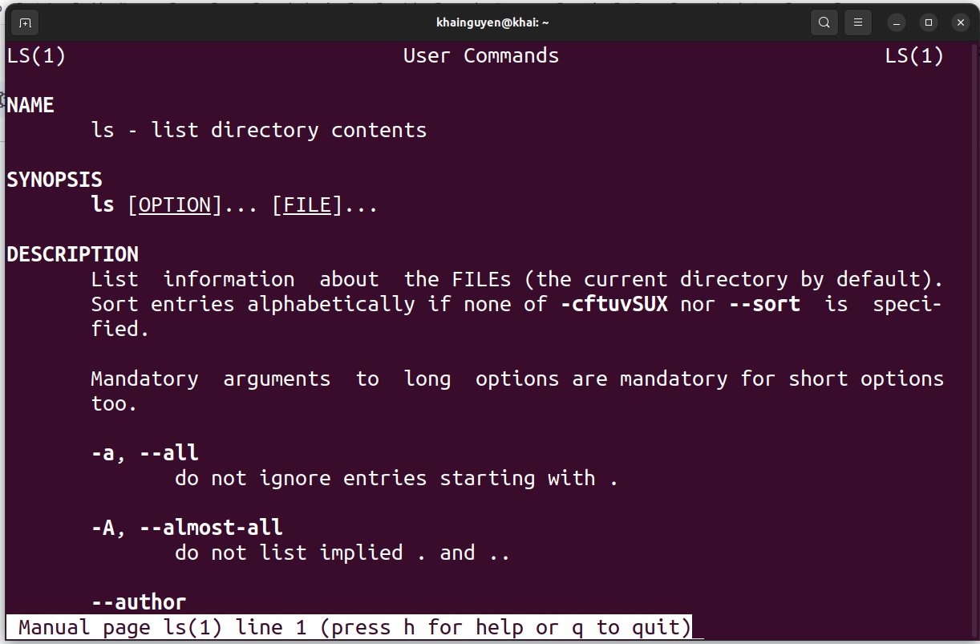
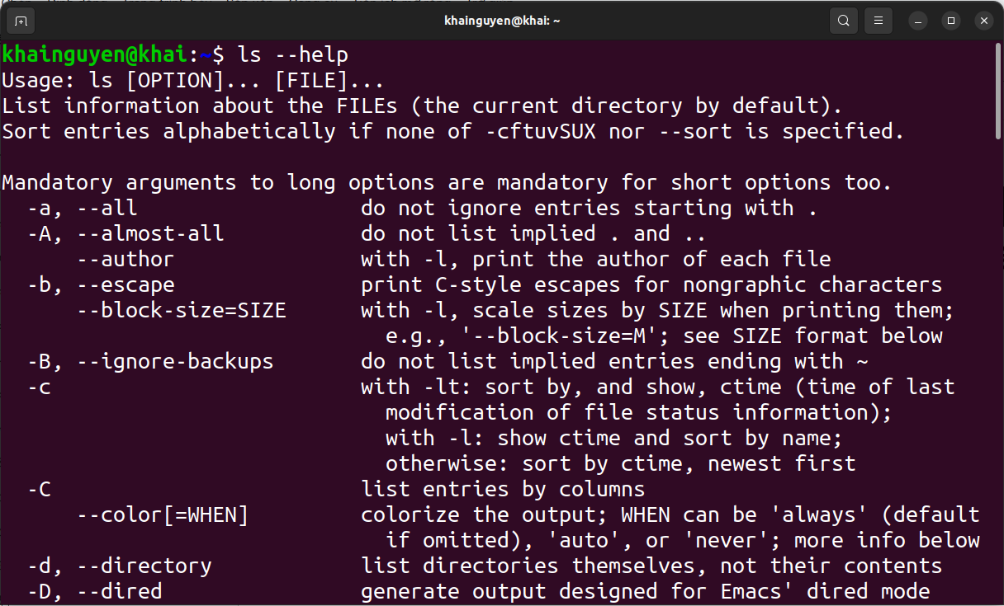
How do I know what options a command has?
man command_name
command_name --help
Example: ls command
Press q key on keyboard to exit

